Slide 1
Materials and Methods
Dataset:
The dataset is offered by Dr. Cooper and Dr. Gutman.
It consists of 185 MRI Brain image volumes with tumor masks.
The MRI images were acquired from the Winship Cancer Institute at Emory University.

Slide 2
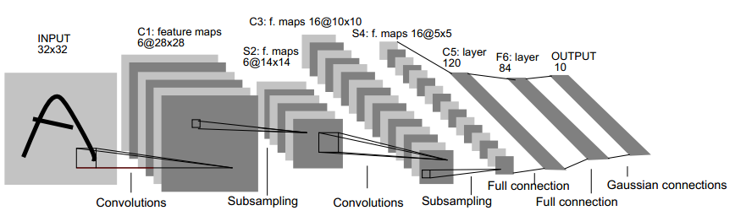
Methods
Convolutional Neural Networks (CNN)
Handwritten Example

Slide 3
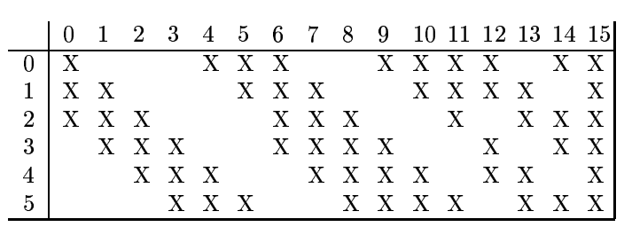
CNN
Relationship map
Hidden Layer m:
16 images
10*10
0 | 1 | 2 | 3 | 4 | 5 | 6 | 7 | 8 | 9 | 10 | 11 | 12 | 13 | 14 | 15
6 Convolution
Kernels
5*5
5*5
5*5
5*5
5*5
5*5
Layer m-1:
6 Images
14*14
14*14
14*14
14*14
14*14
14*14

Slide 4
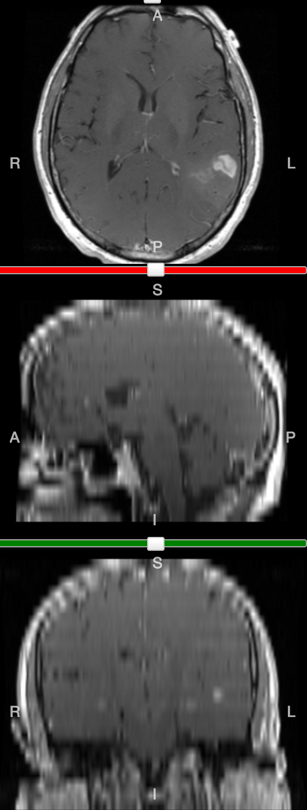
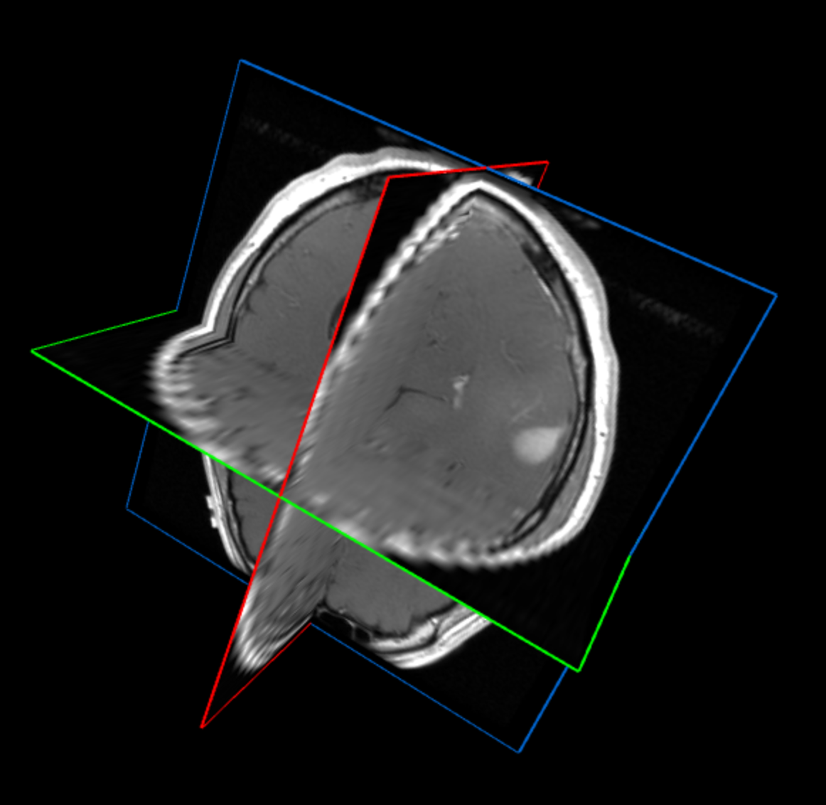
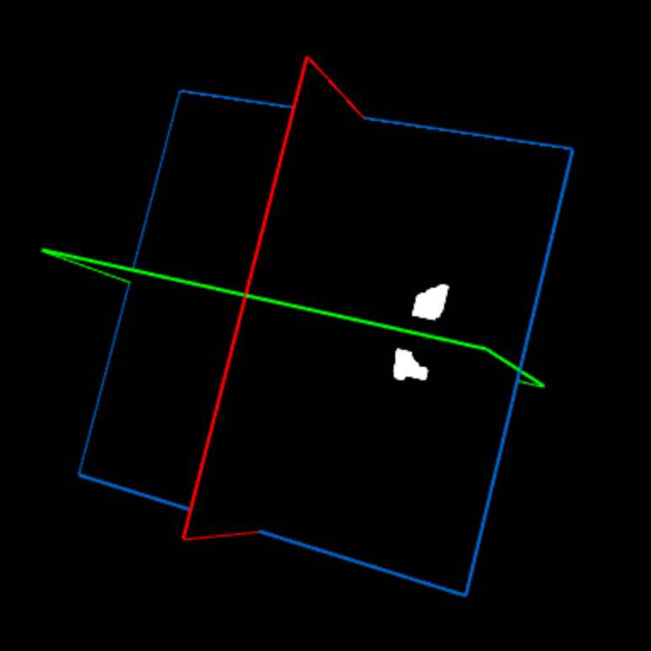
Data Pre-processing
The data contains MRI images with tumor tasks.
Slices of 3 planes.
3D Brain Structure
3D Binary Mask
Images size:
(25,256,256)
Horizontal Plane
Sagittal Plane
3D Brain Structure
Coronal Plane
3D Binary Mask

Slide 5
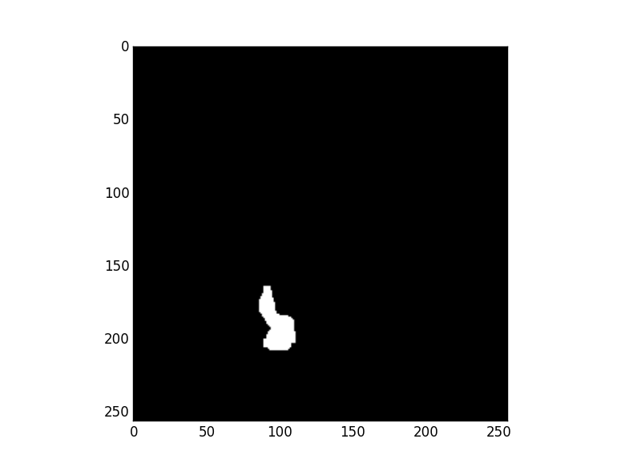
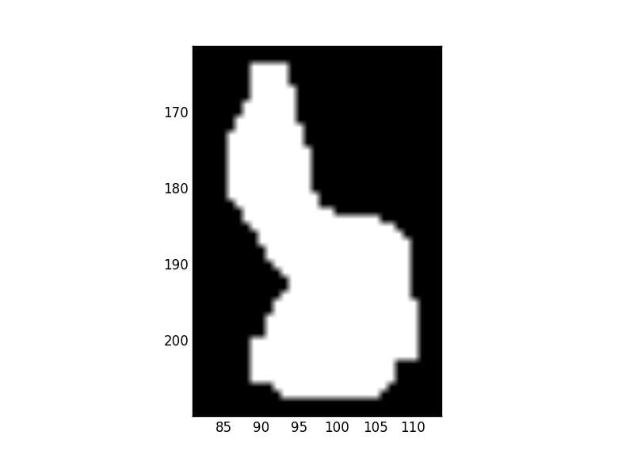
Find Bounding Box
Example:
The 13th slice of a voxel has the
largest bounding box.
Save it and the tumor center.
 | X | Y
1 | X1 | Y1
2 | X2 | Y2
… | … | …
K | Xn | Yn
Max | M | N
 | X | Y
1 | X1 | Y1
2 | X2 | Y2
… | … | …
K | Xn | Yn
Tumor Center
Bounding Box
Original Mask
Tumor Mask

Slide 6
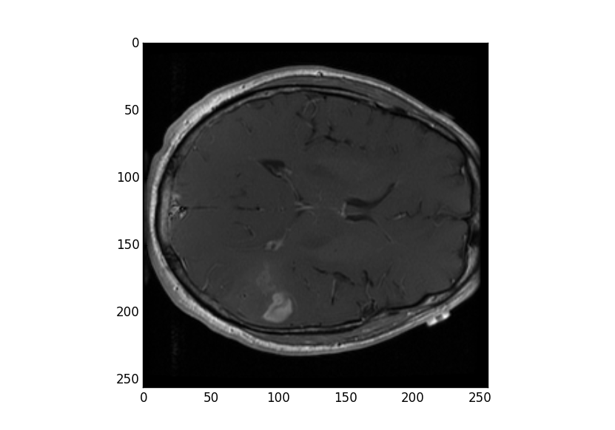
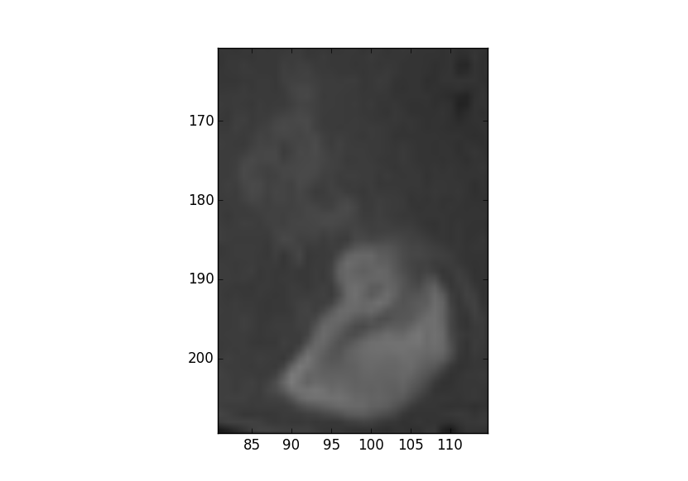
Extract Tumor Image
Using the determined bounding box (M,N) and center (X,Y) to extract the tumor region from the original MRI image.
The tumor region should be [(X-M/2):(X+M/2), (Y-N/2):(Y+N/2)].
In our case, it’s size is (113,139).
Original MRI Image
Extracted Tumor Image

Slide 7
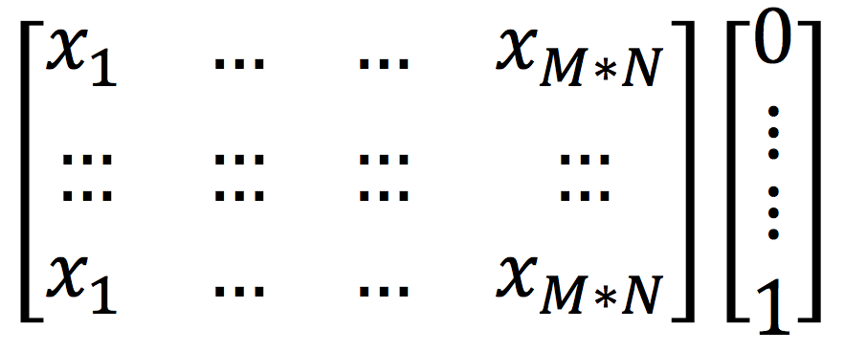
CNN Implement
Input data format:
The previous step has generated K tumor images (size:M*N)
Input data is tuple contains X and Y. X are the reshaped images. Y are the bianry labels. (e.g. Survival; Gene Mutation)
1
M*N
1
K
Input_X
Input_Y

Slide 8
Python Deep Learning
Python Library:
Theano, Logistic Regression, Multilayer Perceptron
CPU vs GPU:

Slide 9
Results
Survival:
Parameters:
Errors:
Dataset size | Training size | Validation size | Test size
133 | 90 | 20 | 23
Layers | n_epoch | n_kernels | Kernel size | Pooling size
4 | 100 | [40, 100] | [16, 16] | [4, 4]
Validation Error | Test Error
35.0% | 40.0%

Slide 10
Results
Gene Mutation:
Parameters:
Errors:
Dataset size | Training size | Validation size | Test size
59 | 40 | 9 | 10
Layers | n_epoch | n_kernels | Kernel size | Pooling size
4 | 100 | [10, 30] | [16, 16] | [4, 4]
Gene | Validation Error | Test Error
EGFR | 12.5% | 30.0%
IDH1 | 12.5% | 10.0%

Slide 11
Discussion
Parameters:
Number of kernels; Kernel size; Pooling size
Futrure:
Mutation: IDH2, PTEN, TP53

